Slide 1
4.2 Logic Gates
Outputs are Boolean functions of inputs
Respond continuously to changes in inputs
With some, small delay
Rising Delay
Falling Delay
a && b
b
Voltage
a
Time

Slide 2
Combinational Circuits
Acyclic Network
Primary
Inputs
Primary
Outputs
Acyclic Network of Logic Gates
Continously responds to changes on primary inputs
Primary outputs become (after some delay) Boolean functions of primary inputs

Slide 3
4.2. Logic Design
Combinational logic
No memory
A set of inputs uniquely and unambiguously specifies what outputs are
Defined by a truth table
e.g. Inputs – A,B,C; Outputs – D,E,F
Design Process: collect input combinations producing ones in the output

Slide 4
Truth Table
A | B | C | D | E | F
0 | 0 | 0 | 0 | 0 | 0
0 | 0 | 1 | 1 | 0 | 0
0 | 1 | 0 | 1 | 0 | 0
0 | 1 | 1 | 1 | 1 | 0
1 | 0 | 0 | 1 | 0 | 0
1 | 0 | 1 | 1 | 1 | 0
1 | 1 | 0 | 1 | 1 | 0
1 | 1 | 1 | 1 | 0 | 1
D = A+B+C
F = A^B^C
E = A’BC + AB’C + ABC’ => canonical form

Slide 5
Bit Equality
Bit equal
a
eq
eq = (a&&b)||(!a&&!b)
b
Generate 1 if a and b are equal

Slide 6
Word Equality
Word-Level Representation
b₆₃
Bit equal
eq₆₃
B
=
Eq
a₆₃
b₆₂
Bit equal
eq₆₂
A
a₆₂
HCL Representation
Eq
bool Eq = (A == B)
b₁
Bit equal
eq₁
a₁
b₀
Bit equal
eq₀
a₀

Slide 7
Bit-Level Multiplexor
s
Bit MUX
HCL Expression
out = (s&&a)||(!s&&b)
b
out
a
multiplexor (mux), selector
Control signal s
Data signals a and b
Output a when s=1, b when s=0

Slide 8
Word Multiplexor
s
Word-Level Representation
s
B
MUX
b₆₃
Out
out₆₃
A
a₆₃
Out = [
s : A;
1 : B;
];
b₆₂
out₆₂
a₆₂
Select input word A or B depending on control signal s
b₀
out₀
a₀

Slide 9
Decoder
Input a,b enables one of 4 outputs
a,b = 00 -> out0
a,b = 01 -> out1
a,b = 10 -> out2
a,b = 11 -> out3
Out0
a
Out1
b
Out2
Out3

Slide 10
1-bit Adder
1-bit Adder: Properties
Fill out a Truth Table
Write out Boolean Expressions for outputs
S = (a’⋅b’⋅Cin) + (a’⋅b⋅Cin’) + (a⋅b’⋅Cin’) + (a⋅b⋅Cin)
Cout =(b ⋅ Cin) + (a ⋅ Cin) + (a⋅b)
Simplify expressions, if possible
Carry-in
a
sum
b
Carry-out
a b Cin S Cout
0 0 0 0 0
0 0 1 1 0
0 1 0 1 0
0 1 1 0 1
0 0 1 0
1 0 1 0 1
1 1 0 0 1
1 1 1 1 1

Slide 11
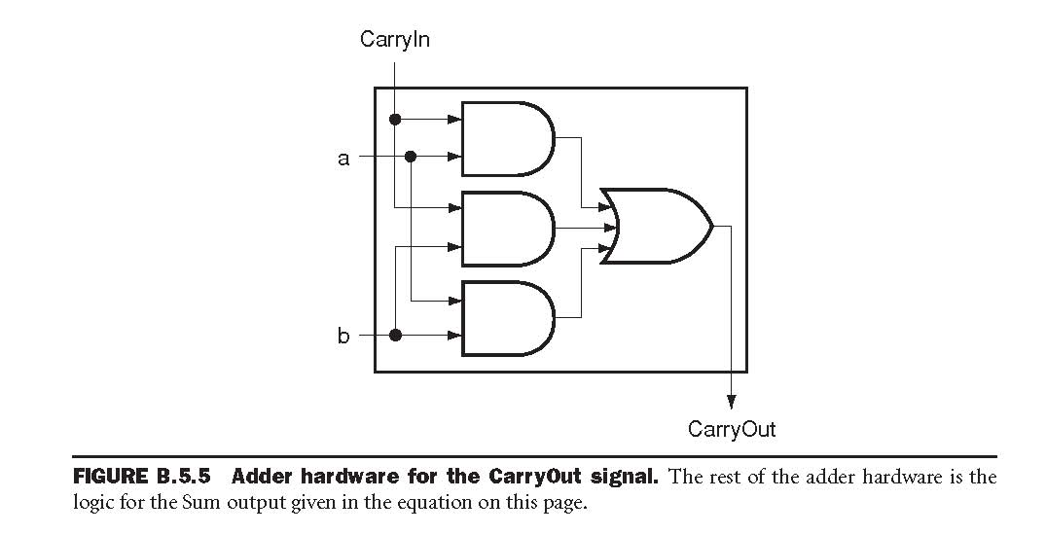
Carry-Out implementation
Cout =(b ⋅ Cin) + (a ⋅ Cin) + (a⋅b)
Similar implementation of Sum (quiz)

Slide 12
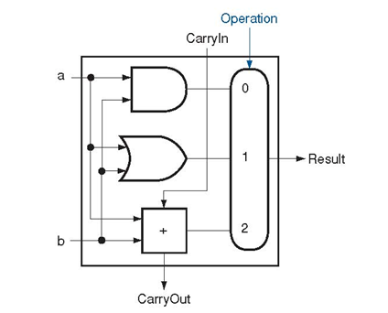
1-bit ALU
1-bit ALU
1-bit adder
Logical unit: and/or

Slide 13
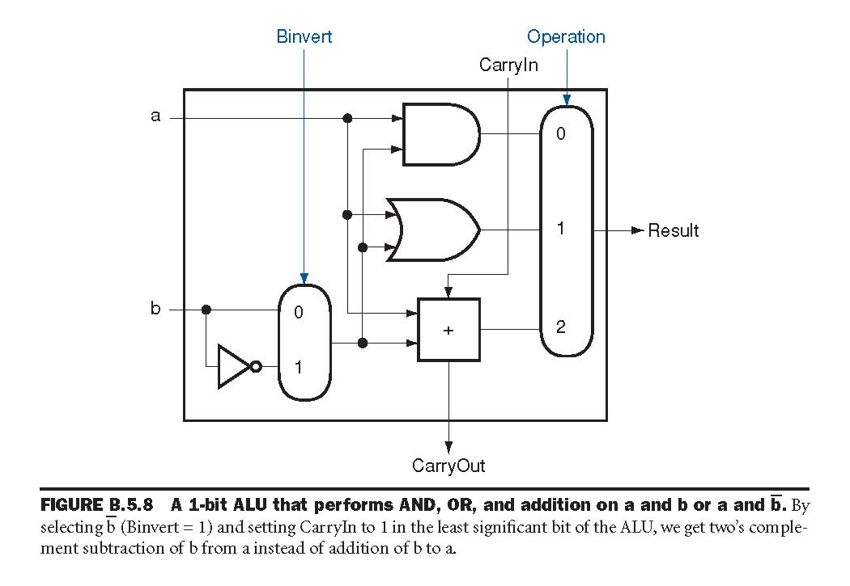
1-bit ALU
Capable of
ADD, AND, and OR
How to add SUB ?
-b = ~b + 1
a – b = a + (b’ + 1)
Add Binvert
How to add 1 ?

Slide 14
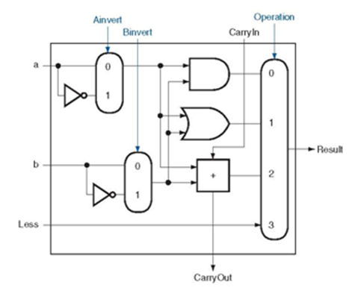
1-bit ALU (Full)
ADD, AND, OR, SUB
How to add NOR ?
(A+B)’ = A’B’

Slide 15
32-bit ALU
CarryIn
Operation
From 1-bit ALU to
32-bit ALU
Chain carry-out to carry-in to the next bit
Set CarryIn in the least significant bit to 1 for subtraction
a₀
CarryIn
ALU₀
CarryOut
Result₀
b₀
a₁
CarryIn
ALU₁
CarryOut
Result₁
b₁
a₂
CarryIn
ALU₂
CarryOut
Result₂
b₂
…
…
…
a₃₁
CarryIn
ALU ₃₁
CarryOut
Result₃₁
b₃₁

Slide 16
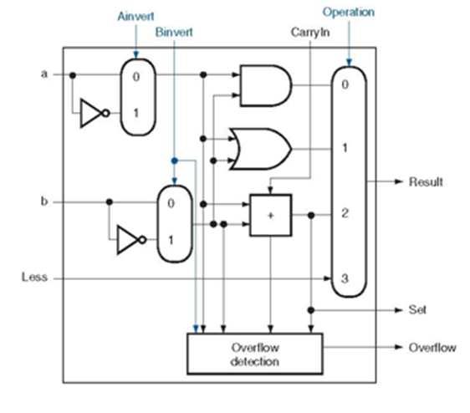
32-bit ALU
Comparison: a < b ?
if a < b, then a-b < 0 => Check for SIGN bit after subtraction
However, the result of subtraction is not of interest
Needs only the sign bit and rest of bits of 0’s

Slide 17
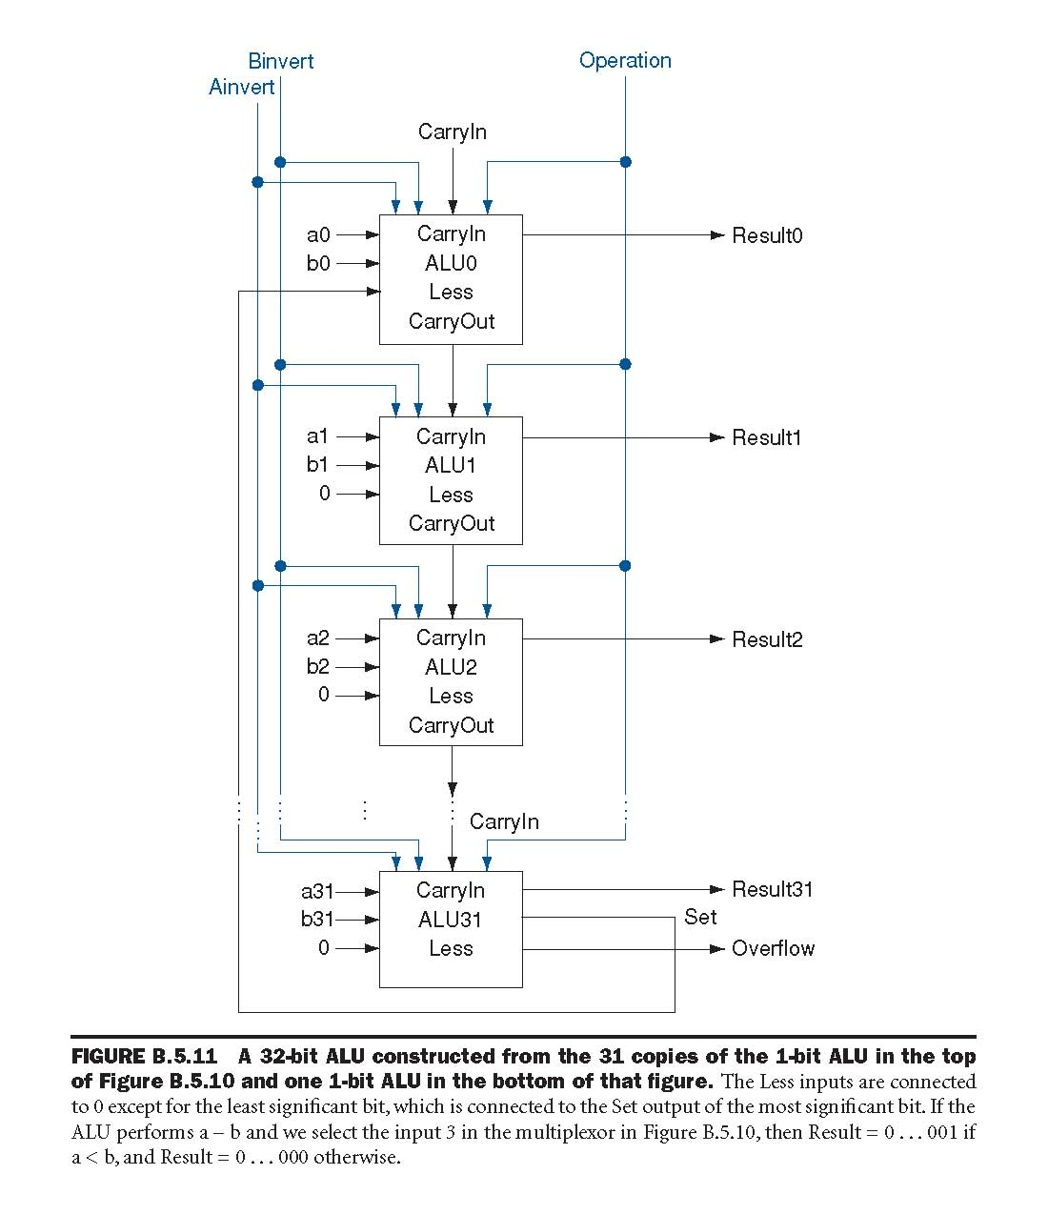

Slide 18
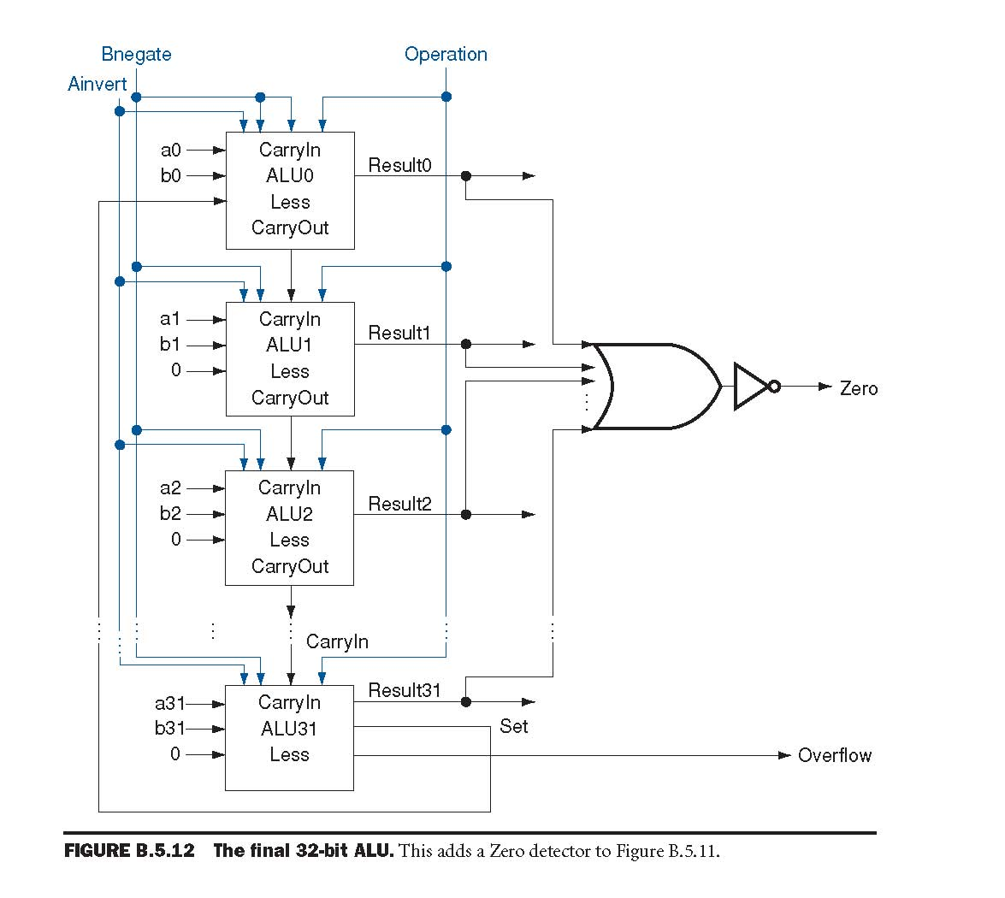
32-bit ALU (Full)
Comparison: a = b (beq) ?
if a = b, then a-b = 0
we subtract b from a, then test for all 0’s
Need a zero detector
Zero = 1 if all result bits are 0’s (couter-intuitive)
Subtraction: Add (b’ + 1)
Use Bnegate = Binvert + CarryIn

